Slide 1
Lecture 2 Mathematical Models

Slide 2
Modeling in the Frequency Domain
In every case the first step in developing a mathematical model is to apply the fundamental physical laws of science and engineering.
For example, when we model electrical networks, Ohm's law and Kirchhoff's laws, which are basic laws of electric networks, will be applied initially.
We will sum voltages in a loop or sum currents at a node. When we study mechanical systems, we will use Newton's laws as the fundamental guiding principles. Here we will sum forces or torques. From these equations we will obtain the relationship between the system's output and input.

Slide 3
A differential equation can describe the relationship between the input and output of a system. The form of the differential equation and its coefficients are a formulation or description of the system. Although the differential equation relates the system to its input and output, it is not a satisfying representation from a system perspective.
Looking at linear, time-invariant differential equation. a general, nth-order, linear, time invariant differential equation, we see that the system parameters, which are the coefficients, as well as the output, c(t), and the input, r(t), appear throughout the equation.
We would prefer a mathematical representation such as that shown in Figure 1, where the input, output, and system are distinct and separate parts. Also, we would like to represent conveniently the interconnection of several subsystems.

Slide 4
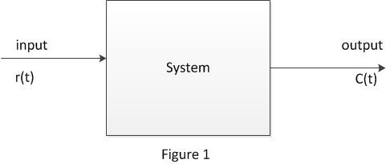
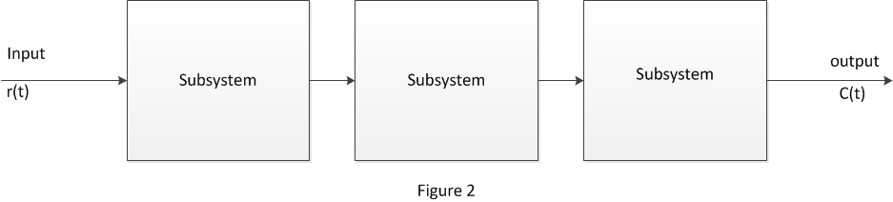
For example, we would like to represent cascaded interconnections, as shown in Figure 2, where a mathematical function, called a transfer function, is inside each block, and block functions can easily be combined to yield Figure 1 for ease of analysis and design. This convenience cannot be obtained with the differential equation.

Slide 5
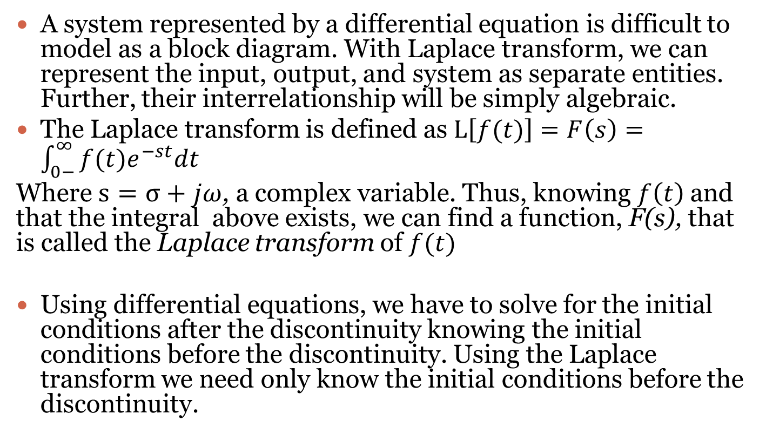
Laplace Transform
A system represented by a differential equation is difficult to model as a block diagram. With Laplace transform, we can represent the input, output, and system as separate entities. Further, their interrelationship will be simply algebraic.
The Laplace transform is defined as $L\left[f(t)\right]=F\left(s\right)=\int_{0−}^{∞}{f(t)e^{−st}dt}$
Where $s=σ+jω$, a complex variable. Thus, knowing $f\left(t\right)$and that the integral above exists, we can find a function, F(s), that is called the Laplace transform of $f(t)$
Using differential equations, we have to solve for the initial conditions after the discontinuity knowing the initial conditions before the discontinuity. Using the Laplace transform we need only know the initial conditions before the discontinuity.

Slide 6
Laplace transform table
Table

Slide 7
Laplace transform table cont’d
Table

Slide 8


Example #1: Find the Laplace transform of
Solution
$$F\left(s\right)=L\left[f\left(t\right)\right]=\int_{0}^{∞}{\left(5+4e^{−2t}\right)e^{−st}dt}$$
$$=\int_{0}^{∞}{5e^{−st}+4e^{−(s+2)t}dt}$$
$$=−\frac{5}{s}\left[0−1\right]−\frac{4}{(s+2)}\left[0−1\right]$$
$$=\frac{5}{s}+\frac{4}{(s+2)}$$
$$=\frac{9s+10}{s(s+2)}$$
$$f\left(t\right)=5+4e^{−2t}$$

Slide 9

Inverse Laplace Transform
Example #2: Find the inverse Laplace transform of $F\left(s\right)=\frac{1}{s+3}$
Solution
$$F\left(s\right)=\frac{1}{s+3}$$
From the Laplace table ,$L\left[e^{−at}\right]=\frac{1}{s+a}$
Therefore if $F\left(s\right)=\frac{1}{s+3}$’
Then $f(t)=e^{−3t}$

Slide 10
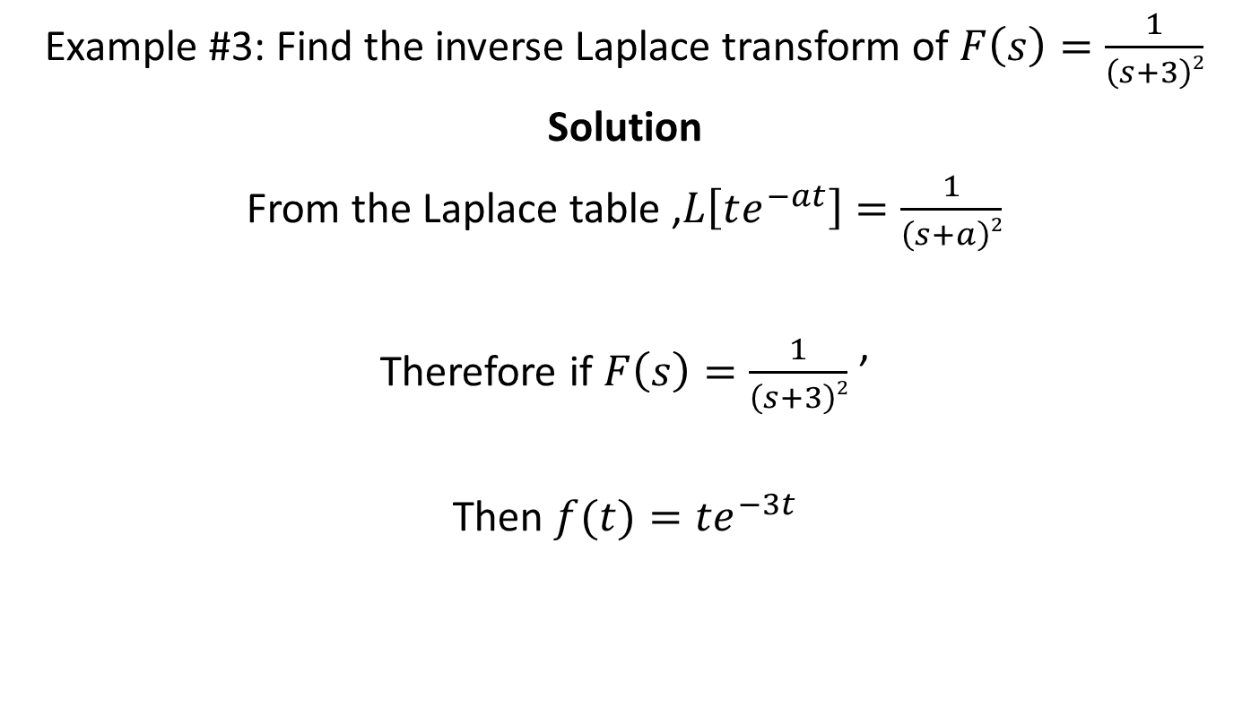
Example #3: Find the inverse Laplace transform of $F\left(s\right)=\frac{1}{\left(s+3\right)2}$
Solution
From the Laplace table ,$L\left[te^{−at}\right]=\frac{1}{\left(s+a\right)2}$
Therefore if $F\left(s\right)=\frac{1}{\left(s+3\right)2}$ ’
Then $f(t)={te}^{−3t}$

Slide 11
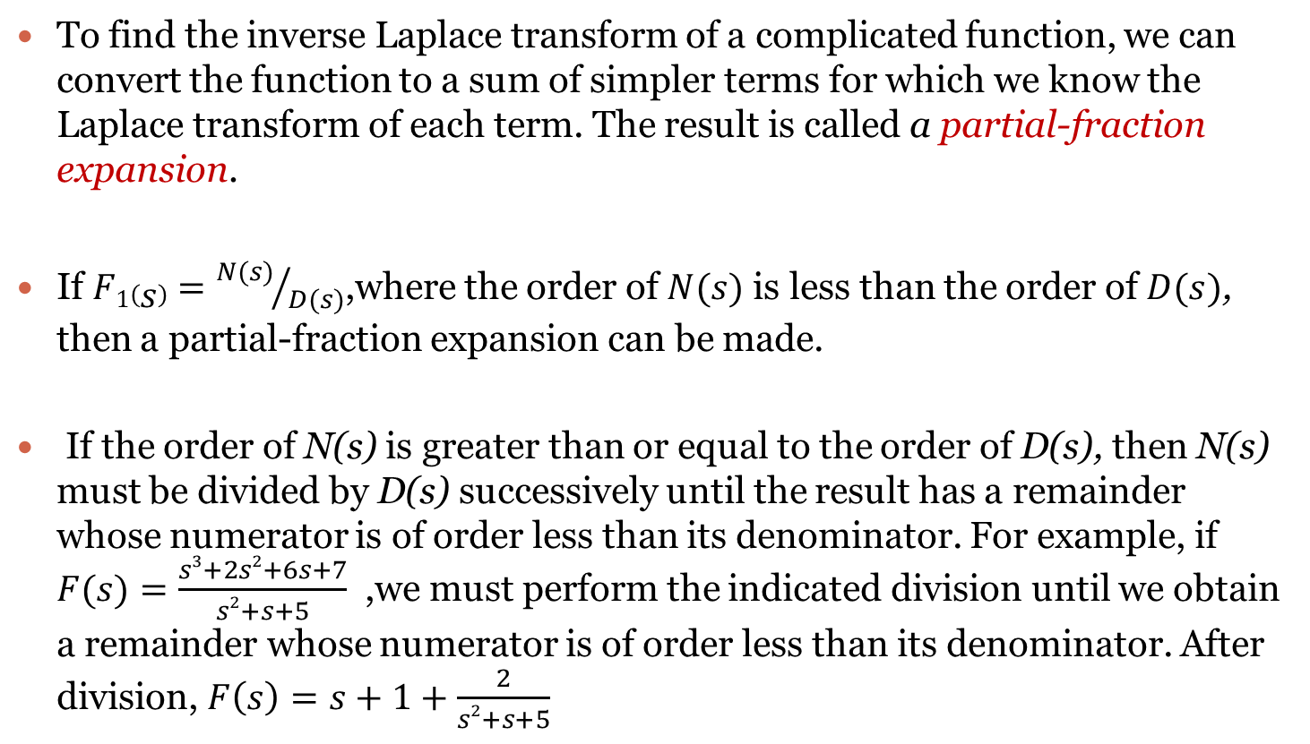
Partial Fraction Expansion
To find the inverse Laplace transform of a complicated function, we can convert the function to a sum of simpler terms for which we know the Laplace transform of each term. The result is called a partial-fraction expansion.
If $F1\left(s\right)={N(s)}/{D(s)}$,where the order of $N(s)$ is less than the order of $D(s)$, then a partial-fraction expansion can be made.
If the order of N(s) is greater than or equal to the order of D(s), then N(s) must be divided by D(s) successively until the result has a remainder whose numerator is of order less than its denominator. For example, if $F(s)=\frac{s3+2s2+6s+7}{s2+s+5}$ ,we must perform the indicated division until we obtain a remainder whose numerator is of order less than its denominator. After division, $F\left(s\right)=s+1+\frac{2}{s2+s+5}$

Slide 12
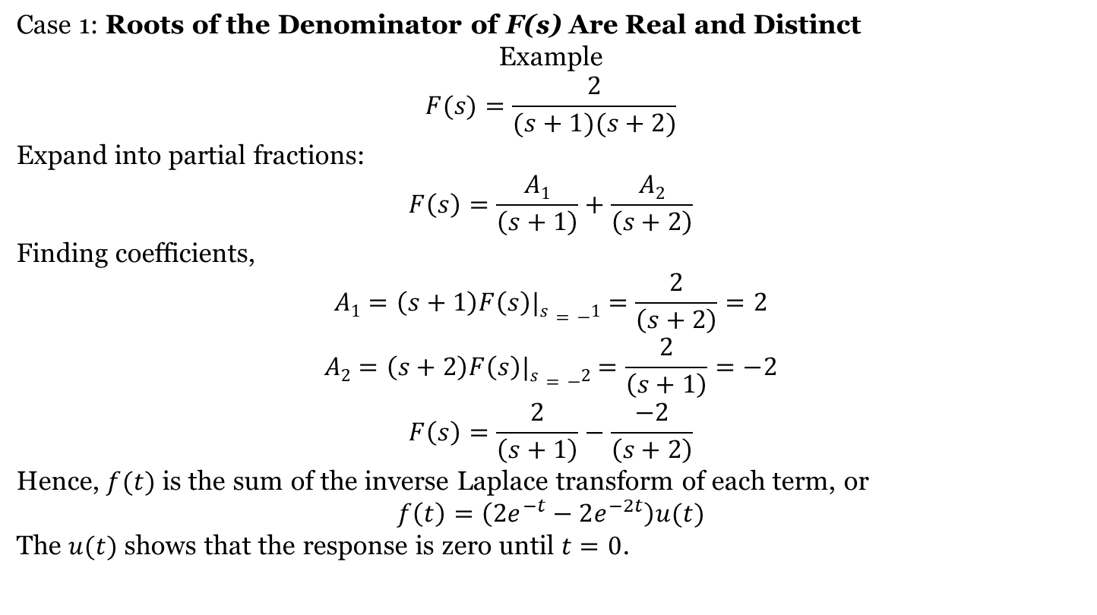
Partial Fraction Expansion Cases
Case 1: Roots of the Denominator of F(s) Are Real and Distinct
Example
$$F(s)=\frac{2}{(s+1)(s+2)}$$
Expand into partial fractions:
$$F\left(s\right)=\frac{A1}{\left(s+1\right)}+\frac{A2}{\left(s+2\right)}$$
Finding coefficients,
$$A1=\left(s+1\right)F\left(s\right)|s=−1=\frac{2}{\left(s+2\right)}=2$$
$$A2=\left(s+2\right)F\left(s\right)|s=−2=\frac{2}{\left(s+1\right)}=−2$$
$$F\left(s\right)=\frac{2}{\left(s+1\right)}−\frac{−2}{\left(s+2\right)}$$
Hence, $f(t)$ is the sum of the inverse Laplace transform of each term, or
$$f\left(t\right)=\left(2e^{−t}−2e^{−2t}\right)u(t)$$
The $u(t)$ shows that the response is zero until $t=0$.

Slide 13
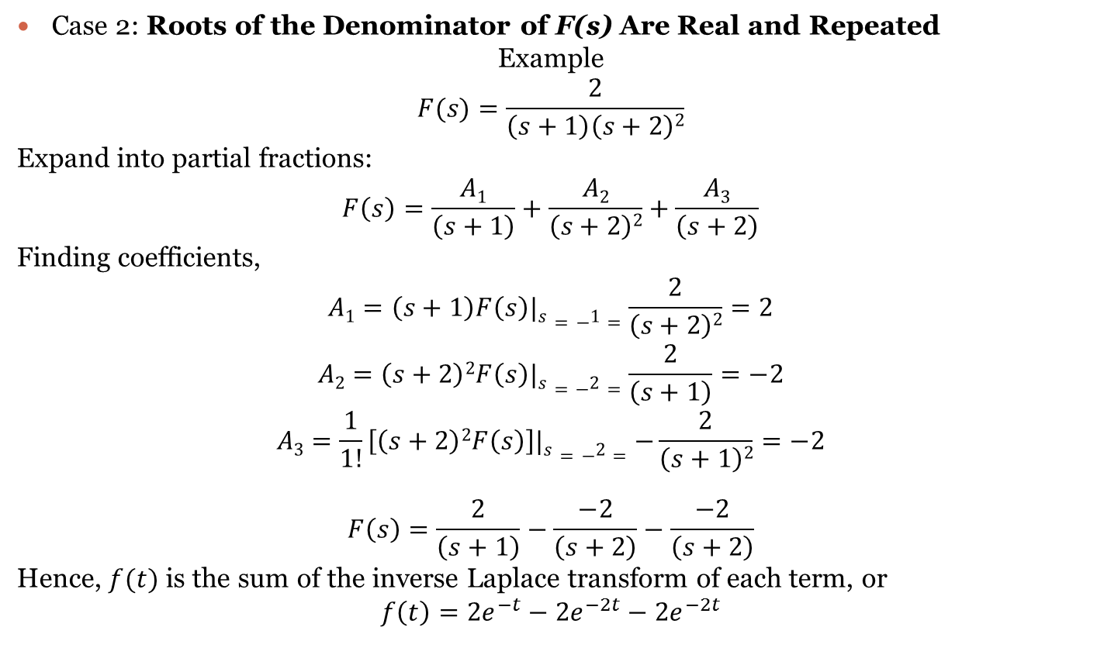
Case 2: Roots of the Denominator of F(s) Are Real and Repeated
Example
$$F(s)=\frac{2}{\left(s+1\right)\left(s+2\right)2}$$
Expand into partial fractions:
$$F\left(s\right)=\frac{A1}{\left(s+1\right)}+\frac{A2}{\left(s+2\right)2}+\frac{A3}{\left(s+2\right)}$$
Finding coefficients,
$$A1=\left(s+1\right)F\left(s\right)|s=−1=\frac{2}{\left(s+2\right)2}=2$$
$$A2=\left(s+2\right)2F\left(s\right)|s=−2=\frac{2}{\left(s+1\right)}=−2$$
$$A3=\frac{1}{1!}\left[\left(s+2\right)2F\left(s\right)\right]|s=−2=−\frac{2}{\left(s+1\right)2}=−2$$
$$F\left(s\right)=\frac{2}{\left(s+1\right)}−\frac{−2}{\left(s+2\right)}−\frac{−2}{\left(s+2\right)}$$
Hence, $f(t)$ is the sum of the inverse Laplace transform of each term, or
$$f\left(t\right)=2e^{−t}−2e^{−2t}−2e^{−2t}$$

Slide 14
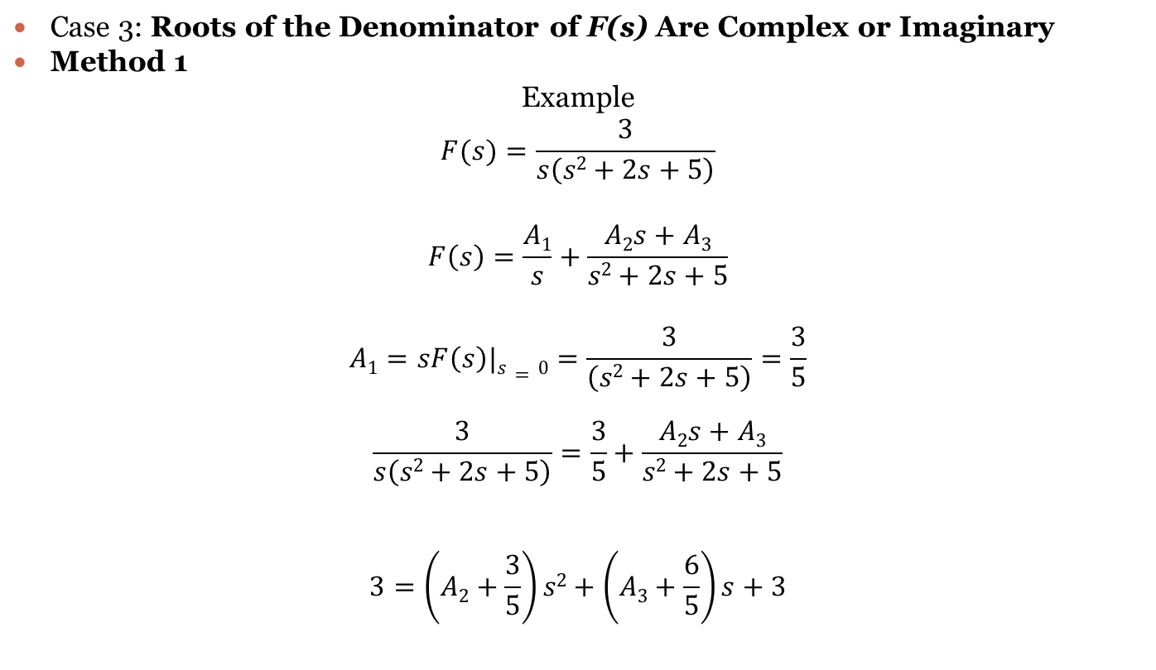
Case 3: Roots of the Denominator of F(s) Are Complex or Imaginary
Method 1
Example
$$F(s)=\frac{3}{s\left(s2+2s+5\right)}$$
$$F\left(s\right)=\frac{A1}{s}+\frac{A2s+A3}{s2+2s+5}$$
$$A1=sF\left(s\right)|s=0=\frac{3}{\left(s2+2s+5\right)}=\frac{3}{5}$$
$$\frac{3}{s\left(s2+2s+5\right)}=\frac{3}{5}+\frac{A2s+A3}{s2+2s+5}$$
$$3=\left(A2+\frac{3}{5}\right)s2+\left(A3+\frac{6}{5}\right)s+3$$

Slide 15
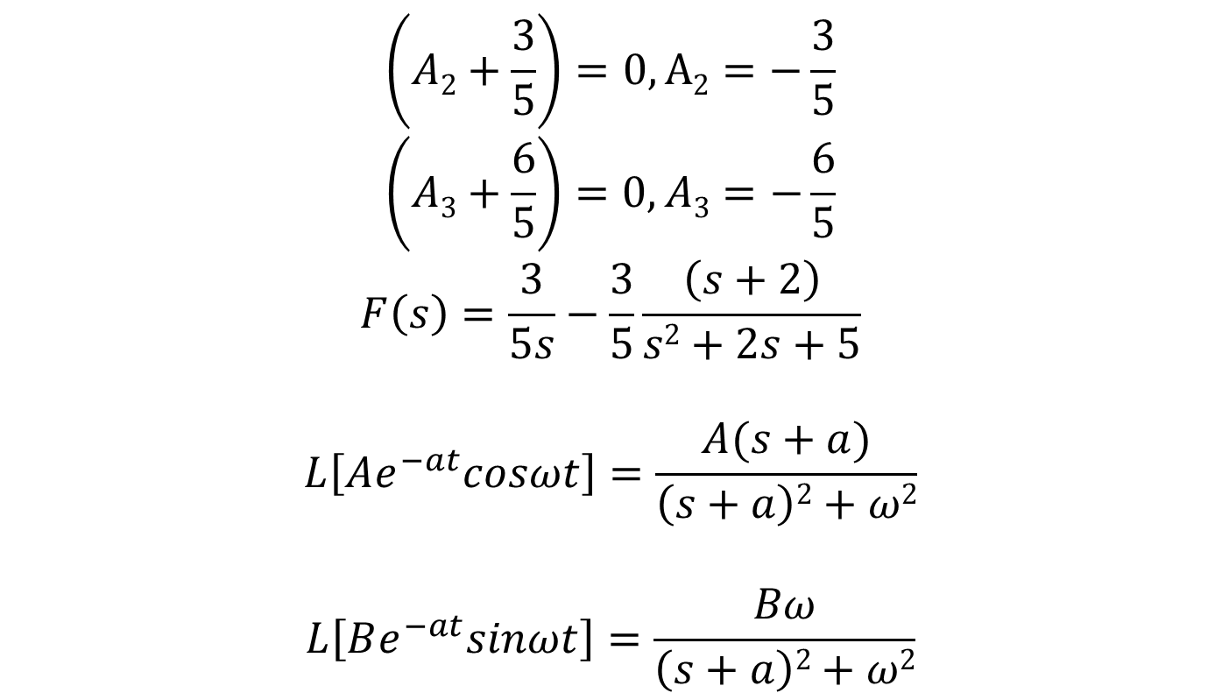
$$\left(A2+\frac{3}{5}\right)=0, A2=−\frac{3}{5}$$
$$\left(A3+\frac{6}{5}\right)=0, A3=−\frac{6}{5}$$
$$F\left(s\right)=\frac{3}{5s}−\frac{3}{5}\frac{\left(s+2\right)}{s2+2s+5}$$
$$L\left[Ae^{−at}cosωt\right]=\frac{A(s+a)}{\left(s+a\right)2+ω2}$$
$$L\left[Be^{−at}sinωt\right]=\frac{Bω}{\left(s+a\right)2+ω2}$$

Slide 16

$$F\left(s\right)=\frac{3}{5s}−\frac{3}{5}\frac{\left(s+1\right)+(1/2)(2)}{\left(s+1\right)2+22}$$
$$f\left(t\right)=\frac{3}{5}−\frac{3}{5}e^{−t}(cos2t+\frac{1}{2}sin2t)$$

Slide 17
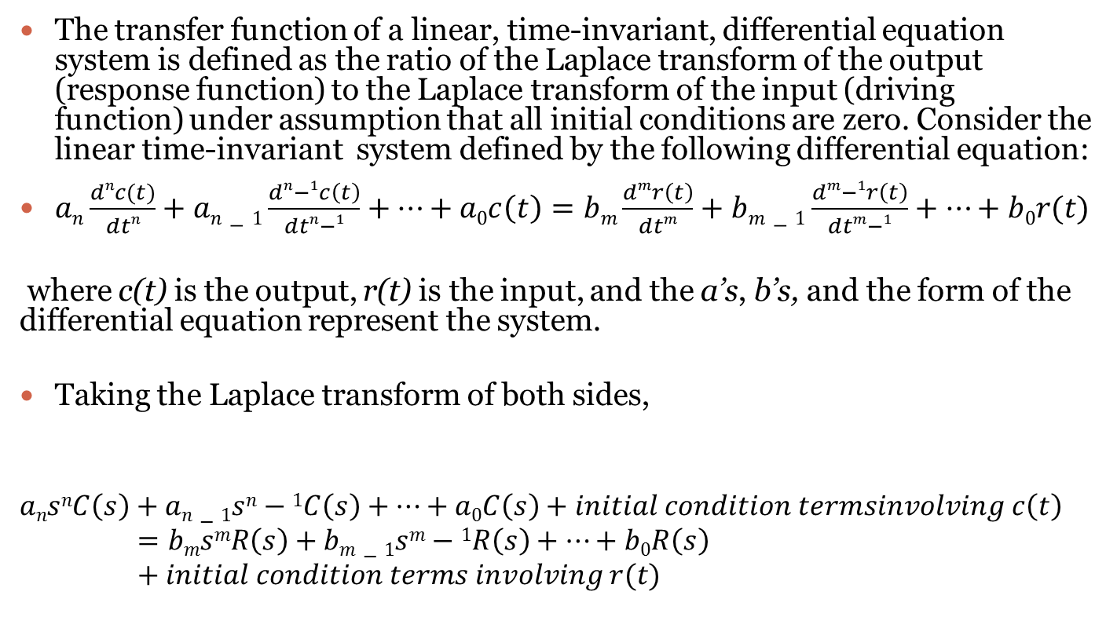
The Transfer Function
The transfer function of a linear, time-invariant, differential equation system is defined as the ratio of the Laplace transform of the output (response function) to the Laplace transform of the input (driving function) under assumption that all initial conditions are zero. Consider the linear time-invariant system defined by the following differential equation:
$an\frac{dnc(t)}{dtn}+an−1\frac{dn−1c\left(t\right)}{dtn−1}+…+a0c\left(t\right)=bm\frac{dmr\left(t\right)}{dtm}+bm−1\frac{dm−1r\left(t\right)}{dtm−1}+…+b0r(t)$
where c(t) is the output, r(t) is the input, and the a’s, b’s, and the form of the differential equation represent the system.
Taking the Laplace transform of both sides,
$$ansnC\left(s\right)+an−1sn−1C\left(s\right)+…+a0C\left(s\right)+initial condition termsinvolving c\left(t\right)=bmsmR\left(s\right)+bm−1sm−1R\left(s\right)+…+b0R\left(s\right)+initial condition terms involving r(t)$$

Slide 18
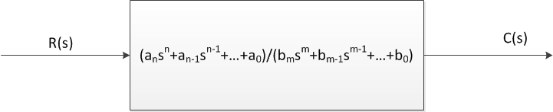
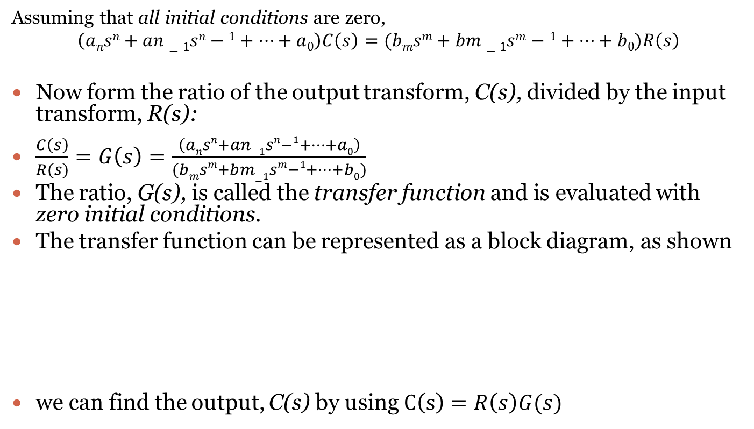
Assuming that all initial conditions are zero,
$$\left(ansn+an−1sn−1+…+a0\right)C\left(s\right)=(bmsm+bm−1sm−1+…+b0)R\left(s\right)$$
Now form the ratio of the output transform, C(s), divided by the input transform, R(s):
$\frac{C\left(s\right)}{R(s)}=G\left(s\right)=\frac{\left(ansn+an−1sn−1+…+a0\right)}{(bmsm+bm−1sm−1+…+b0)}$
The ratio, G(s), is called the transfer function and is evaluated with zero initial conditions.
The transfer function can be represented as a block diagram, as shown
we can find the output, C(s) by using $C\left(s\right)=R\left(s\right)G(s)$

Slide 19
Electrical Network Transfer Functions
Equivalent circuits for the electric networks that we work with first consist of three passive linear components: resistors, capacitors, and inductors.
We combine these electrical components into circuits, decide on the input and output, and find the transfer function. Our guiding principles are Kirchhoff s laws.
We sum voltages around loops or sum currents at nodes, depending on which technique involves the least effort in algebraic manipulation, and then equate the result to zero.
From these relationships we can write the differential equations for the circuit. Then we can take the Laplace transforms of the differential equations and finally solve for the transfer function.

Slide 20
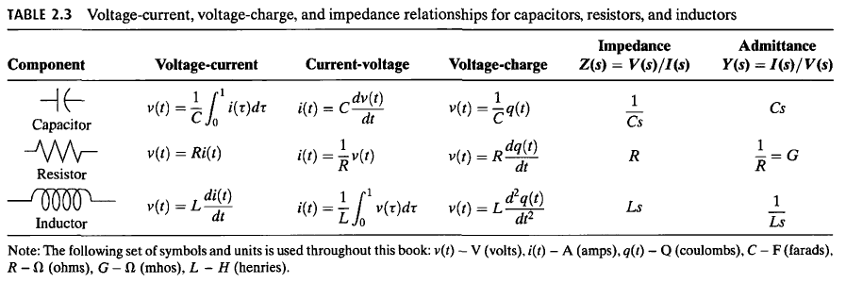
Relationship between three passive linear components for electric networks

Slide 21
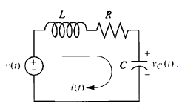
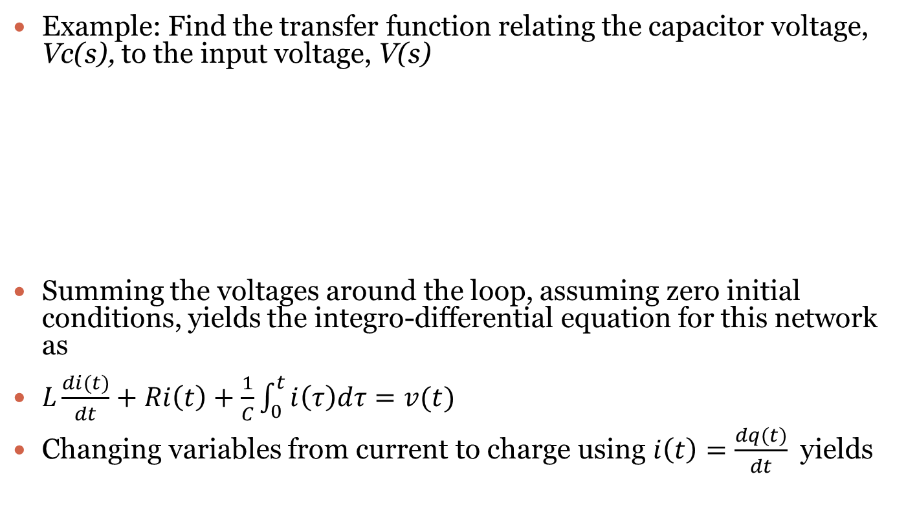
Example: Find the transfer function relating the capacitor voltage, Vc(s), to the input voltage, V(s)
Summing the voltages around the loop, assuming zero initial conditions, yields the integro-differential equation for this network as
$L\frac{di(t)}{dt}+Ri\left(t\right)+\frac{1}{C}\int_{0}^{t}{i\left(τ\right)dτ=v(t)}$
Changing variables from current to charge using $i\left(t\right)=\frac{dq(t)}{dt}$ yields

Slide 22

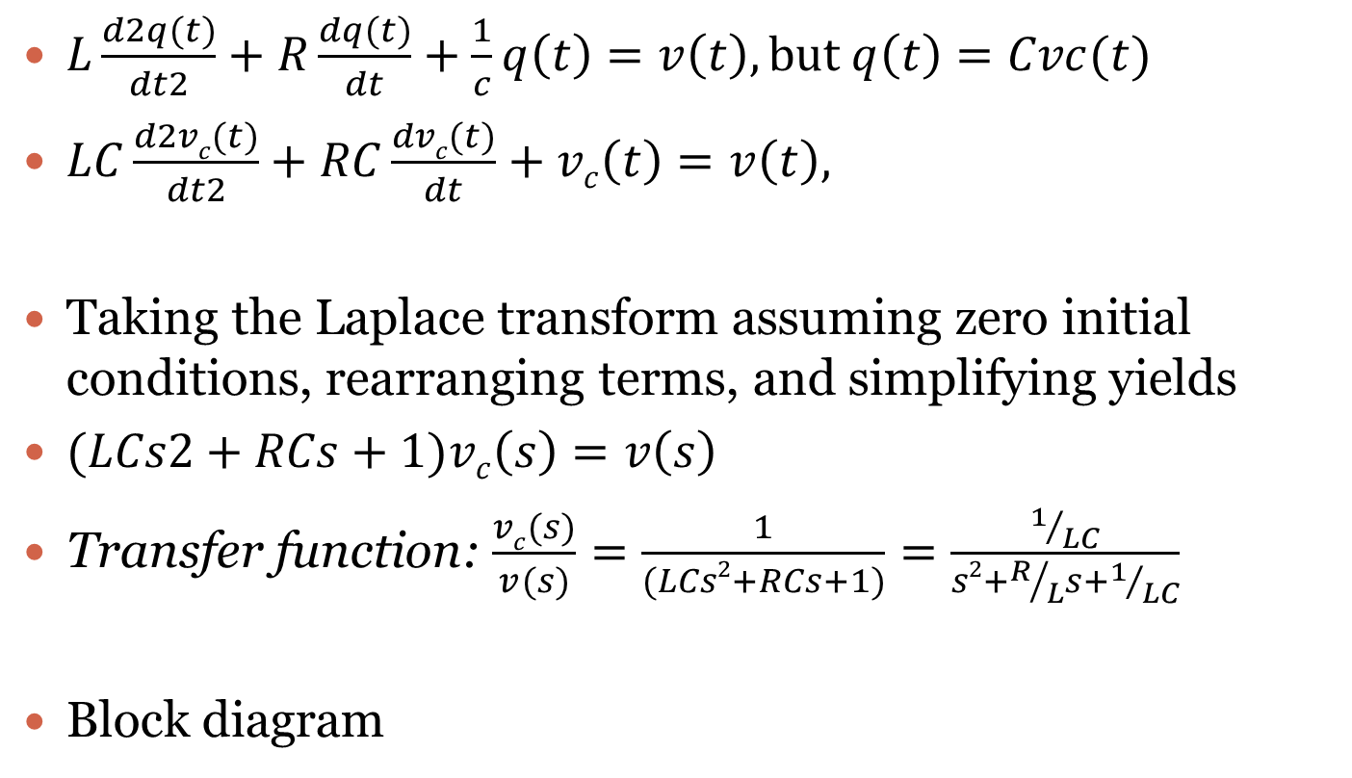
$L\frac{d2q(t)}{dt2}+R\frac{dq(t)}{dt}+\frac{1}{c}q\left(t\right)=v\left(t\right), but q\left(t\right)=Cvc(t)$
$LC\frac{d2vc(t)}{dt2}+RC\frac{dvc(t)}{dt}+vc\left(t\right)=v\left(t\right),$
Taking the Laplace transform assuming zero initial conditions, rearranging terms, and simplifying yields
$(LCs2+RCs+1)vc\left(s\right)=v\left(s\right)$
Transfer function: $\frac{vc(s)}{v(s)}=\frac{1}{(LCs2+RCs+1)}=\frac{1/{LC}}{s2+R/Ls+1/{LC}}$
Block diagram

Slide 23
Translational Mechanical System Transfer Functions
Mechanical systems parallel electrical networks to such an extent that there are analogies between electrical and mechanical components and variables.
Mechanical systems, like electrical networks, have three passive, linear components. Two of them, the spring and the mass, are energy-storage elements; one of them, the viscous damper, dissipates energy.
The two energy-storage elements are analogous to the two electrical energy-storage elements, the inductor and capacitor.
The energy dissipater is analogous to electrical resistance.

Slide 24
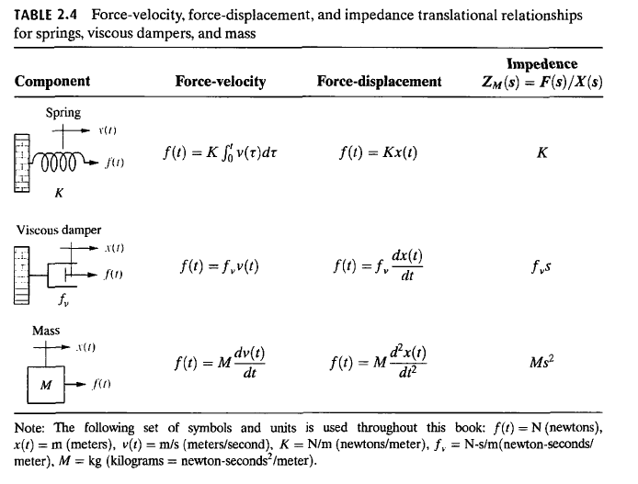
Relationship between three passive linear components for electric networks
K, fv, and M are called spring constant, coefficient of viscous friction, and mass, respectively

Slide 25
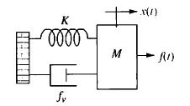
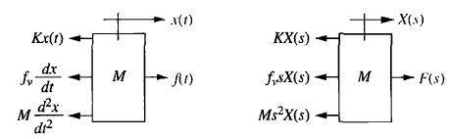
Example: Find the transfer function, X(s)/F(s), for the system shown below:
Begin the solution by drawing the free-body diagram

Slide 26

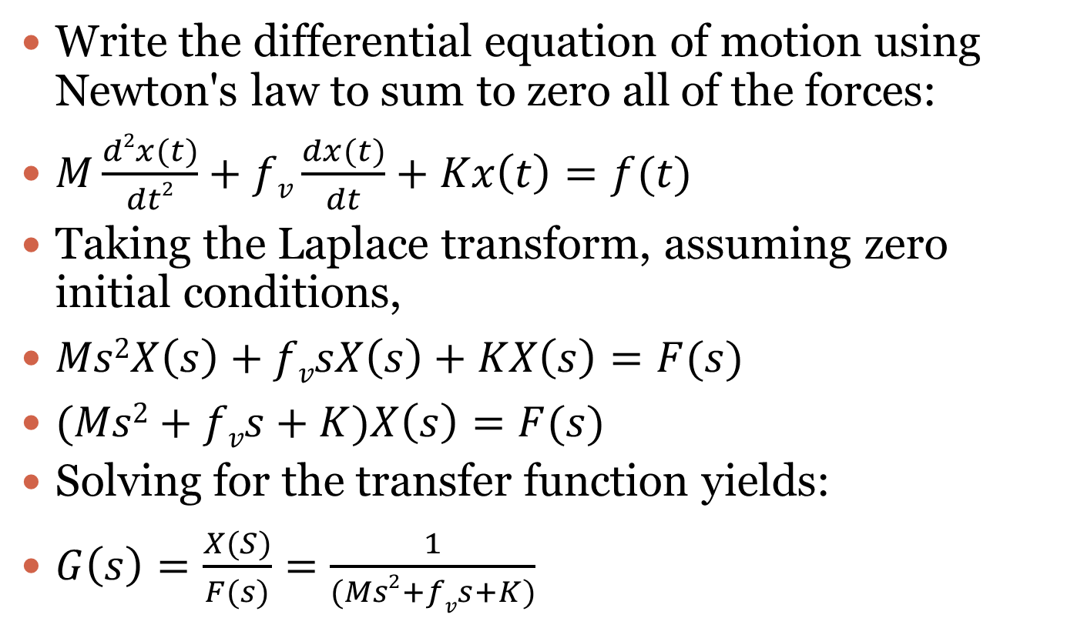
Write the differential equation of motion using Newton's law to sum to zero all of the forces:
$M\frac{d2x(t)}{dt2}+fv\frac{dx(t)}{dt}+Kx\left(t\right)=f(t)$
Taking the Laplace transform, assuming zero initial conditions,
$Ms2X\left(s\right)+fvsX\left(s\right)+KX\left(s\right)=F(s)$
$(Ms2+fvs+K)X\left(s\right)=F(s)$
Solving for the transfer function yields:
$G\left(s\right)=\frac{X(S)}{F(s)}=\frac{1}{(Ms2+fvs+K)}$

Slide 27
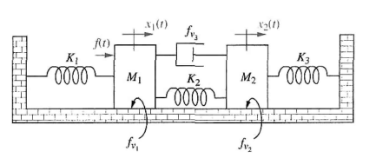
Try the following
1. Find the transfer function, X2(s)/F(s), for the system shown:

Slide 28
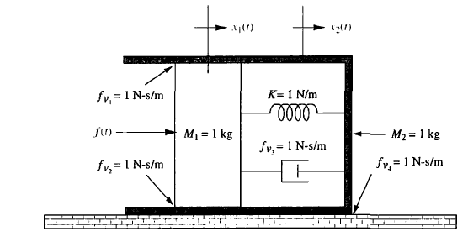
2. Find the transfer function, G(s) = X2(s)/F(s), for the translational mechanical system shown:

Slide 29
Rotational Mechanical System Transfer Functions
Rotational mechanical systems are handled the same way as translational mechanical systems, except that torque replaces force and angular displacement replaces translational displacement.
The mechanical components for rotational systems are the same as those for translational systems, except that the components undergo rotation instead of translation.

Slide 30
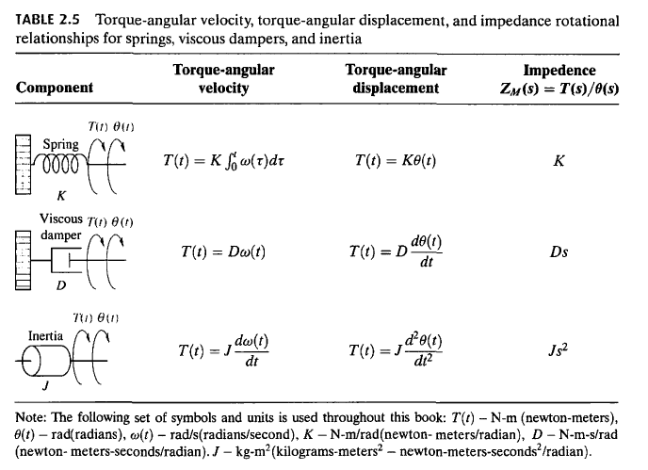
Relationship between components

